Slide 1


Topic : Student Innovation Domain : Agriculture Team ID : T193 Team members : K.Tharani(2303A52067) B.Rithima(2303A52471) Ayesha(2303A52065) P.Lalith(2303A52012)

Slide 2



Objective
Empower farmers with a one-stop digital solution.
Eliminate middlemen and increase crop selling profits.
Provide access to verified storage (godams) and essential farming supplies.
Offer guidance and support through expert and community interaction.
Enable smart decision-making through data and market insights.

Slide 3
Problem Statement
Current Challenges:
Farmers lack easy access to affordable agri-inputs.
Crop prices are heavily controlled by middlemen.
Unsold crops get wasted due to lack of storage awareness.
Farmers have limited support to get expert guidance or resolve doubts.
No centralized platform for farming needs.

Slide 4
Existing system
Feature | Current Scenario | Limitations
Buying Inputs: | Offline/agri shops | High cost, limited availability
Selling Crops : | Middlemen or local market | Low profit margins, no transparency
Storage Options : | Godams, but unknown to farmers | Lack of awareness & accessibility
Expert Help : | Occasional visits | No consistent or accessible support
.

Slide 5
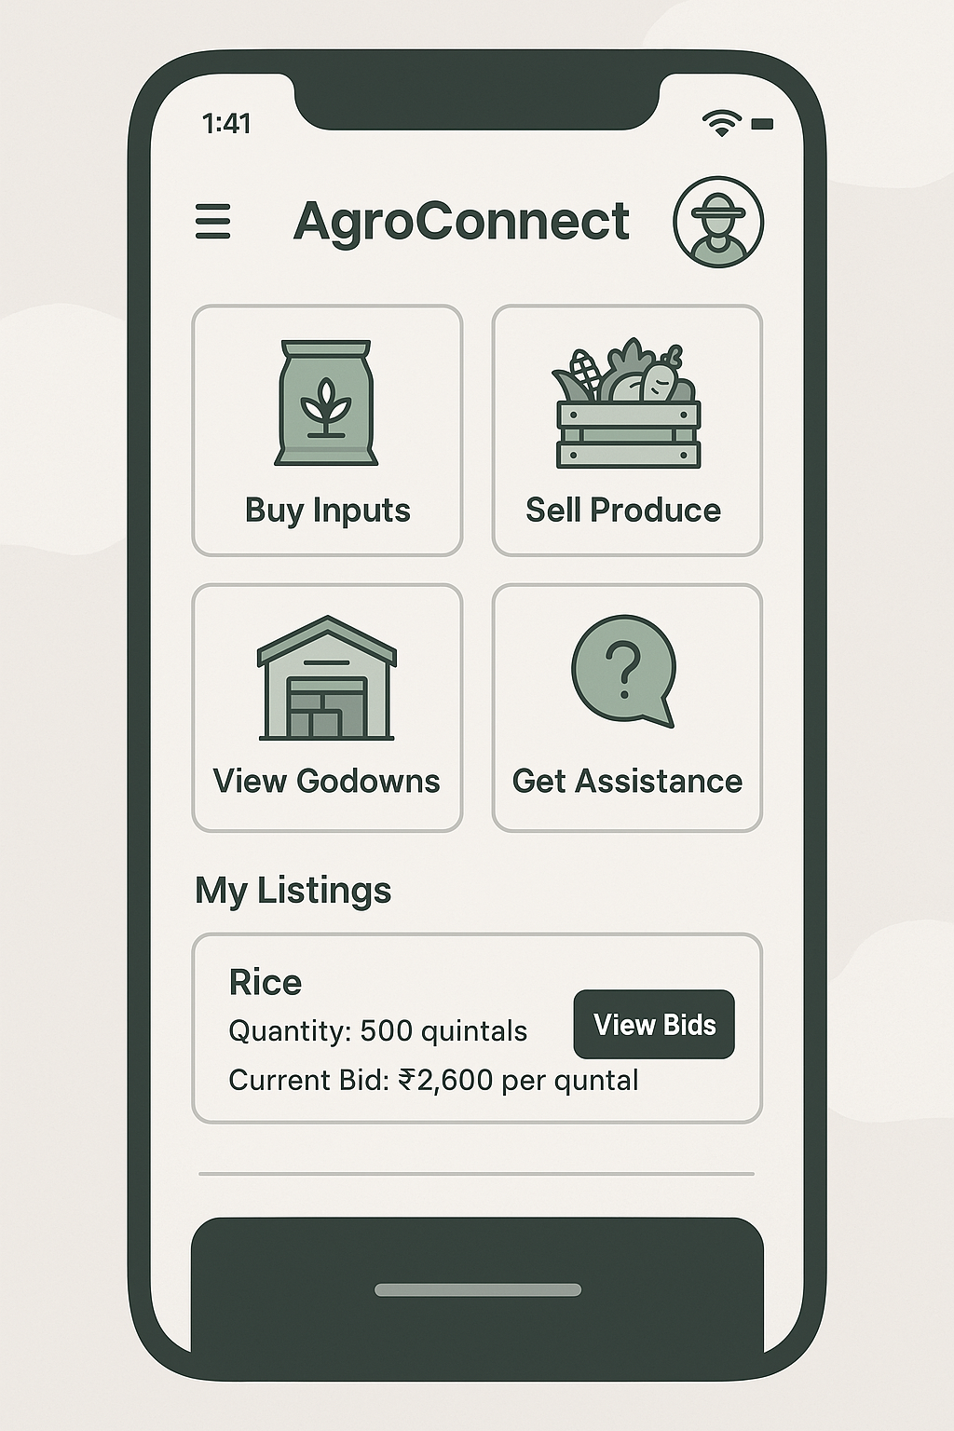
Proposed system
Key Features:
🌱 Buy seeds, fertilizers & pesticides from trusted sellers.
📦 Find and book godams with rental details.
💸 Sell crops to multiple buyers via bidding or price offer system.
📊 Get live market rates and insights.
🧠 Connect with experts or post queries.
🎙️ Voice support and native language interface.

Slide 6
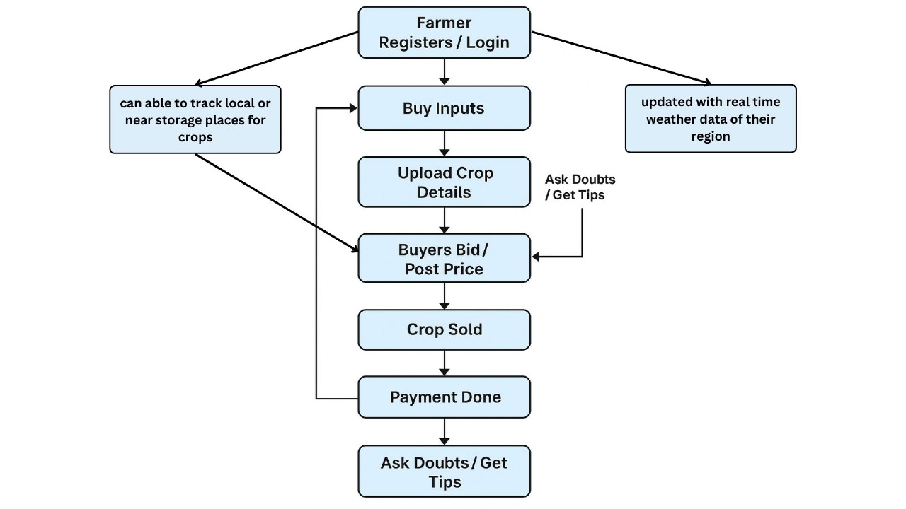
Workflow

Slide 7
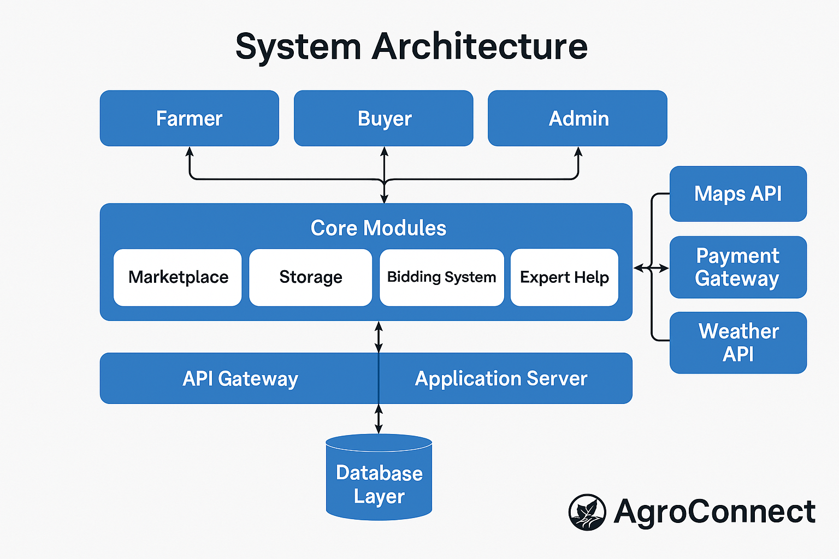
System Architecture
Tech Stack
Front end: Html, Css, Js
Backend: Node.js
Database: PostgreSQL
Hosting: Netlify (present)
Maps API (for godam locations)
Weather API
UPI / Payment Gateway (Razorpay/Stripe)

Slide 8
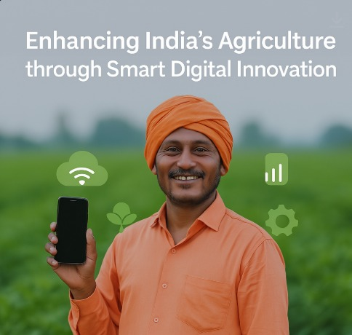
Conclusion & Future Scope
AgroConnect bridges the gap between farmers and the agri-ecosystem.
Boosts productivity, profit, and knowledge for rural communities.
Future Scope:
Integration with government subsidy APIs.
Predictive AI-based crop suggestions.
Logistics support for inter-state transport.
Voice-AI for fully hands-free usage.
"Let’s empower the backbone of our country with smart tools and bright solutions!"

